Slide 1
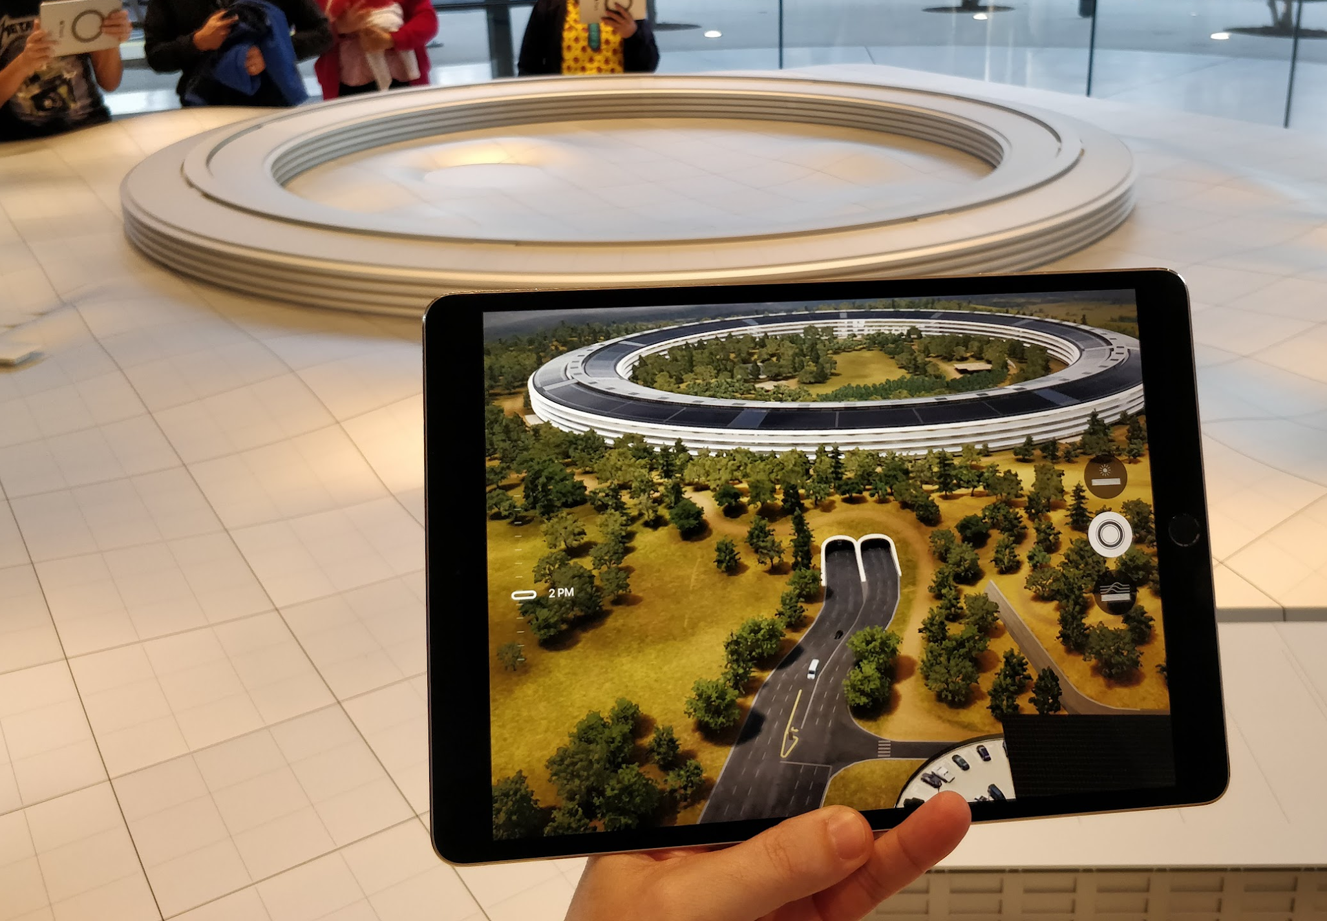
Introduction to Virtual Reality, Augmented Reality
& 360-Tours
2:30 - 3:30
For the UVic Libraries
Digital Scholarship Commons
dscommons@uvic.ca
uvic.ca/library/dsc/

Slide 2
Outline for Today
Introductions
Overview of VR, AR, and 3D Scanning
Virtual Reality (VR) - Everyone will take a turn in the VR Room!
3D Scanning with Qlone activity

Slide 3
Introductions
Name
Faculty / Department
One thing you hope to get out of the workshop today

Slide 4
The DSC “Cool Project” Contest!
Enter to win a “Cool Project” contest prize of $5 printing for a 3D print job and a DSC Cool Project badge, email a link or photo of your project to: dscommons@uvic.ca
All submissions to the “Cool Project” contest will be entered into a random draw for a $5 printing for one 3D print job!
Rules:
Winners will have their project poster or link highlighted on the DSC social media accounts and the DSC blog.
To enter you must email a link to the project or a picture of it to: dscommons@uvic.ca
To win a prize you must be a UVic student, but faculty, staff and the public can enter and can win a DSC Cool Project badge and have their project highlighted on DSC social media accounts and blog.
"Cool Project" winners will be chosen by DSC staff.
Participation prizes will be randomly drawn.

Slide 5
What are Virtual Reality, 360-Video, and Augmented Reality?

Slide 6
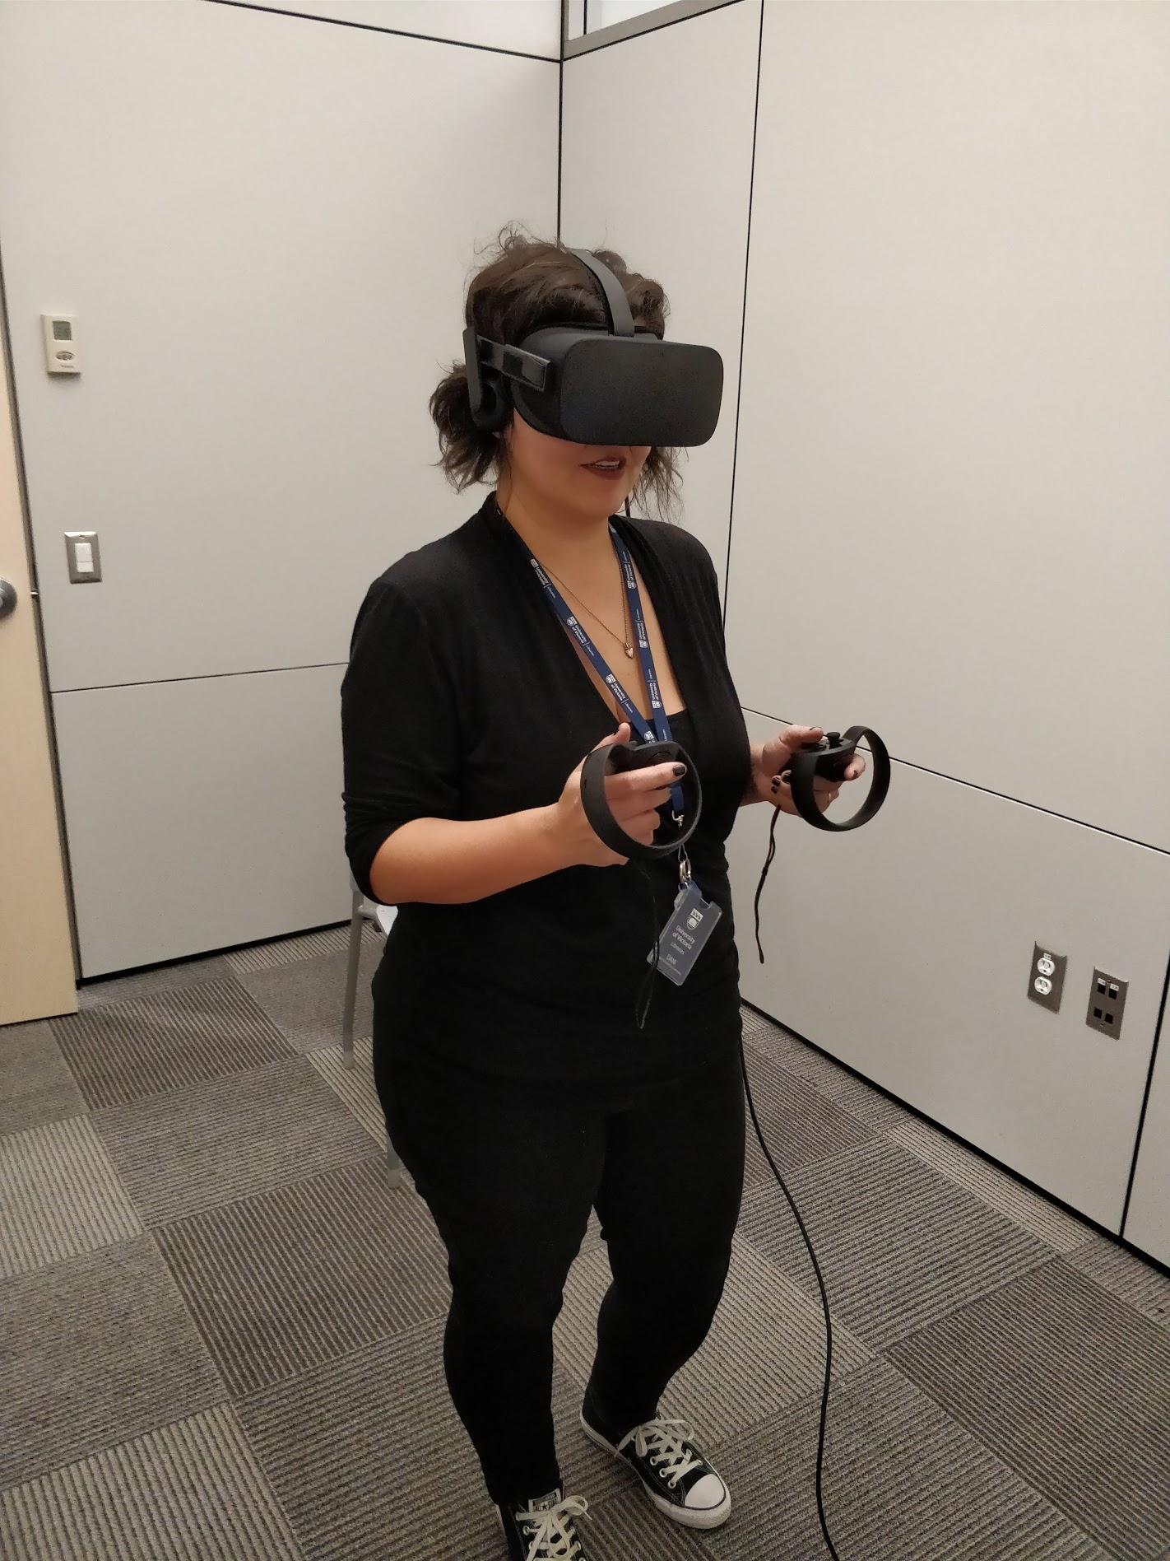
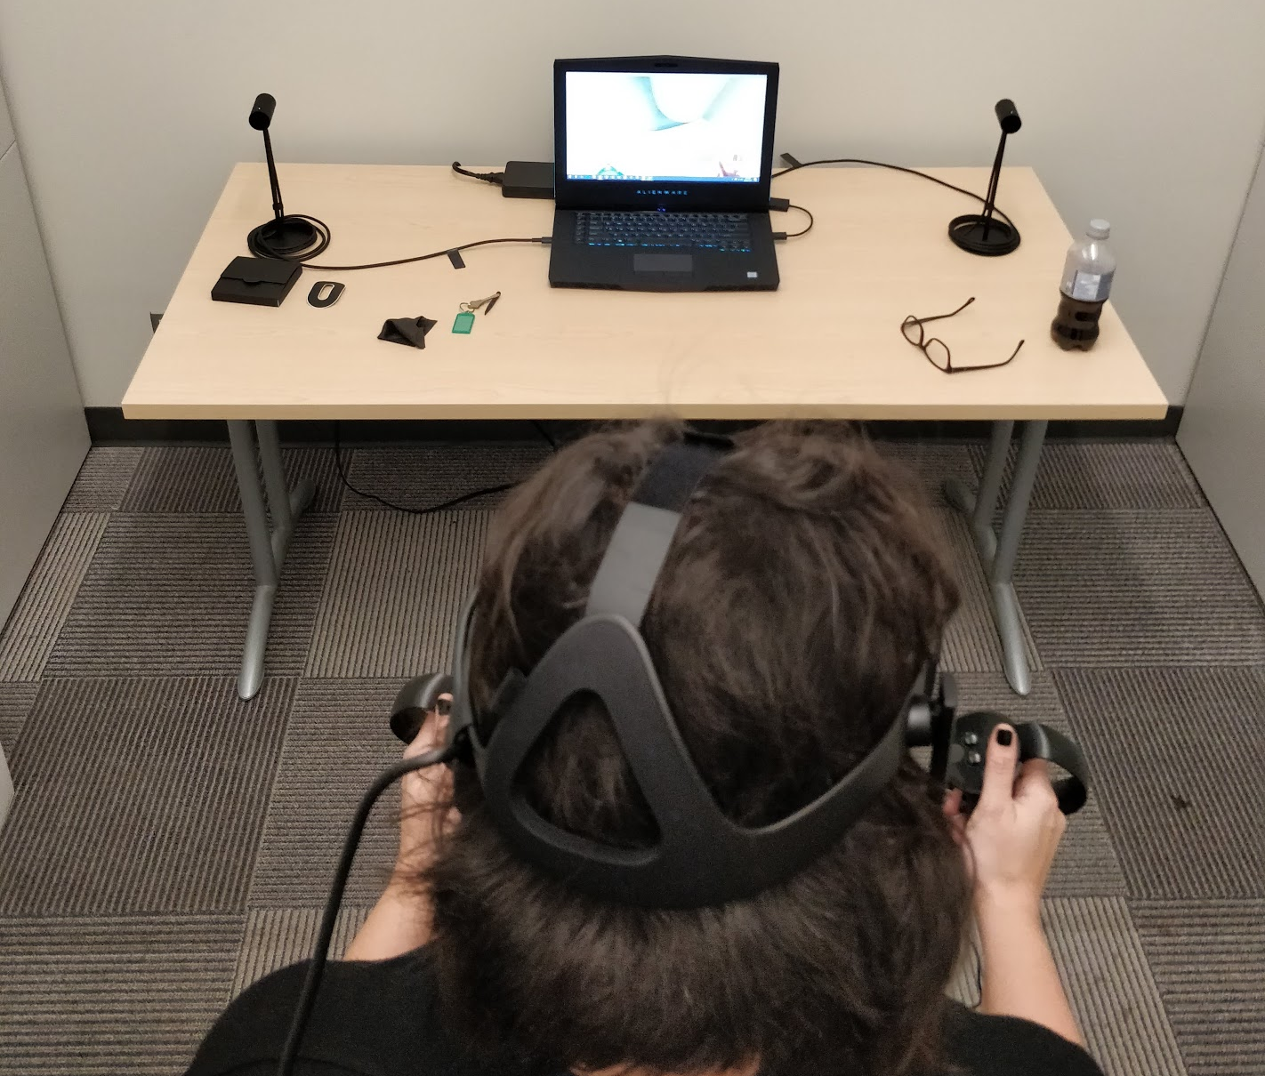
Virtual Reality
Notes:
Everyone will get ~10 minutes in the room… We’ll have 2 people in the room at the same time.
When 1 person is done, she/he will go out and get another person so they can get training while the other person is using the tool.
While you are using the VR equipment, please reflect on the different ways you might use VR as a teaching tool.

Slide 7
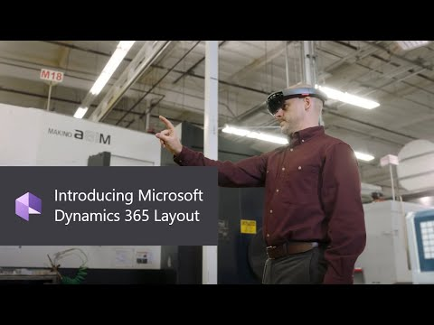
Augmented Reality: @work
Notes:
Hololens remote assist demo -> https://youtu.be/J-C6GE2gFYw?t=60
Layout demo -> https://youtu.be/9viR6U-D2Co?t=50

Slide 8
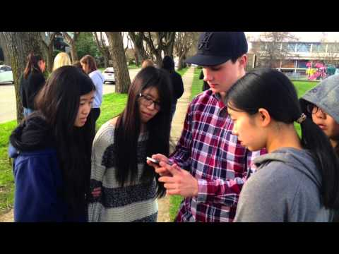
Augmented Reality
Notes:
An AR example from Kitsilano high school in Vancouver … A WW1 AR field trip using Aris: https://www.youtube.com/watch?v=tt6rn5fVnN4
The Aris Website: https://fielddaylab.org/make/aris/

Slide 9
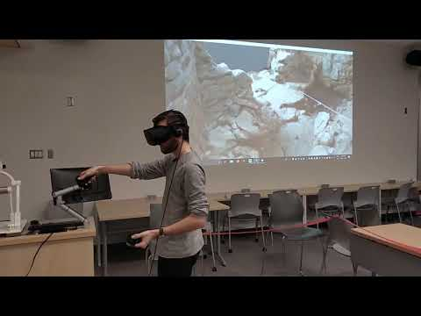
Experiential Learning @ UVic

Slide 10

An Education Group Project
WastelandClimateAnxiety.com
Notes:
https://www.wastelandclimateanxiety.com/3d-tour

Slide 11
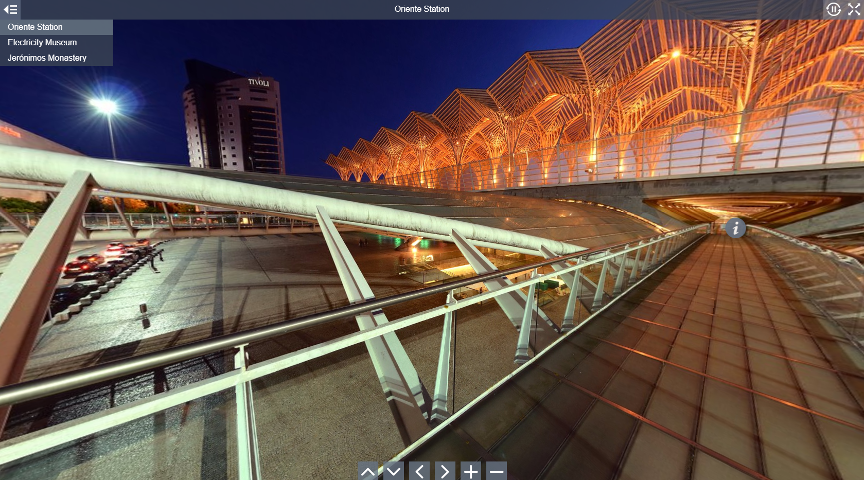
360 Tours: Marzipano
Notes:
https://www.marzipano.net/demos.html

Slide 12
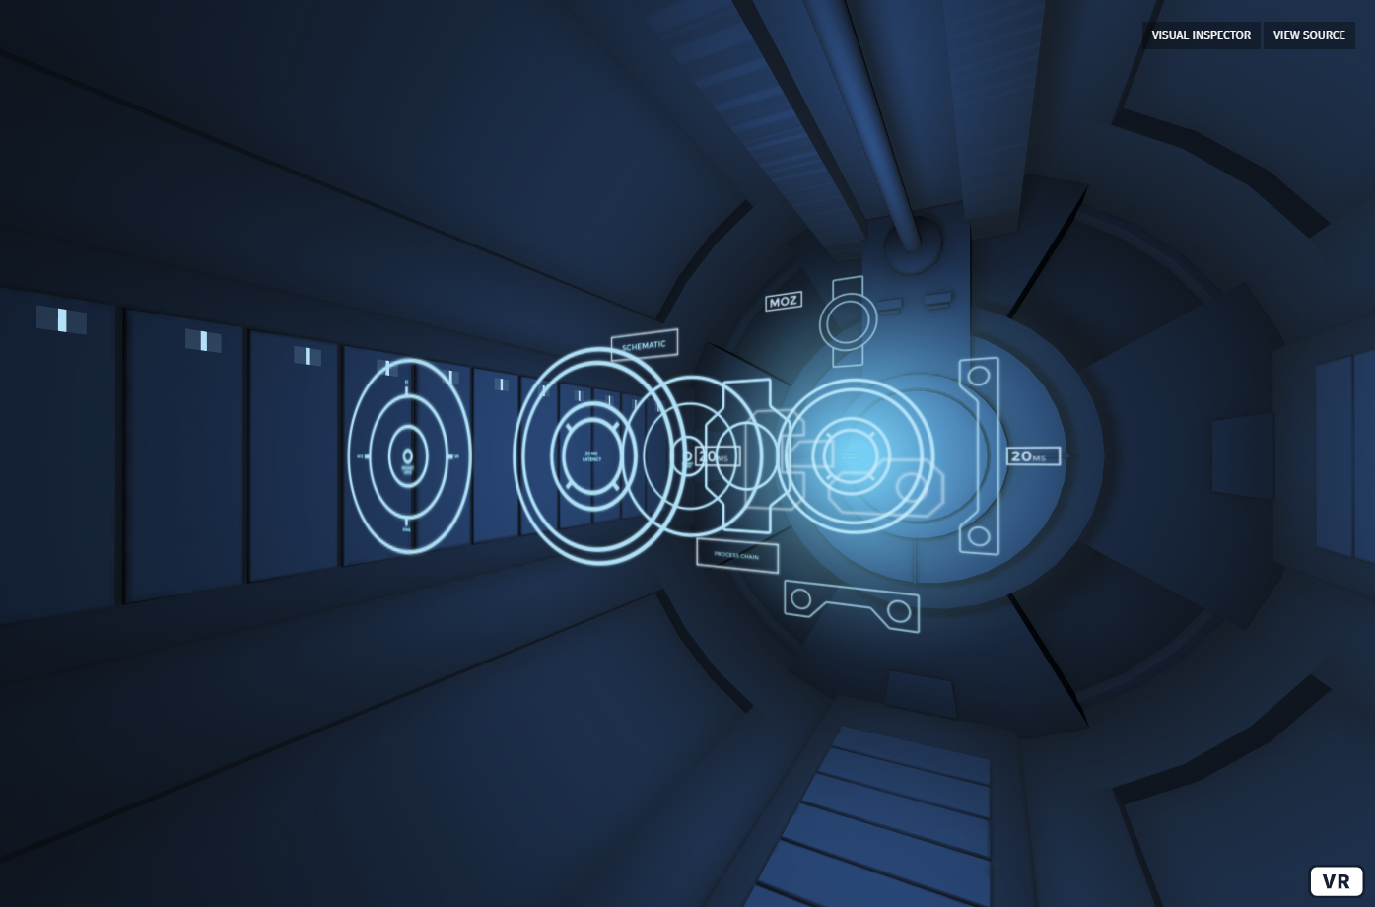
Build 3D Experiences: A-Frame
Notes:
https://aframe.io/examples/showcase/hello-metaverse/

Slide 13
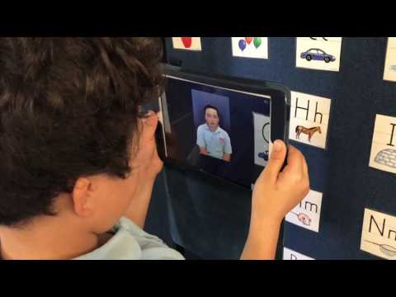
AR with HP Reveal
Notes:
https://www.hpreveal.com/
https://youtu.be/BpIRYtzlPSQ

Slide 14
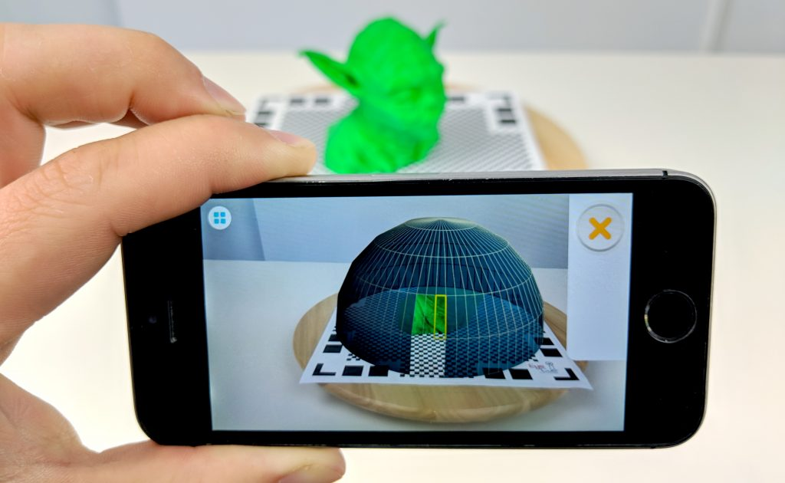
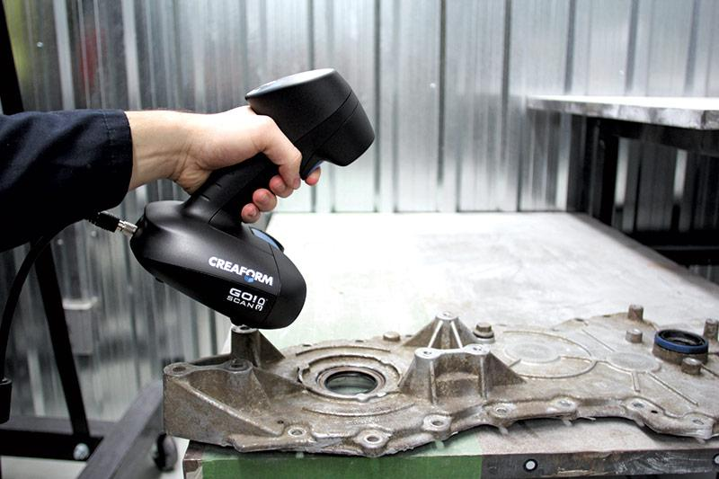
3D Scanning: Objects
Notes:
The top photo is the phone photography based Qlone software (photogrammetry).
Below is the Creaform Go!SCAN system that uses lasers and produces very high resolution scans.

Slide 15
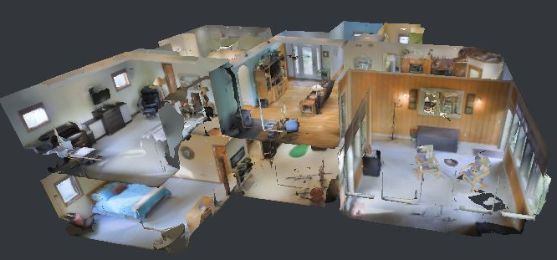
3D Scanning: Landscapes
Notes:
We won’t cover this, but it is very cool.

Slide 16
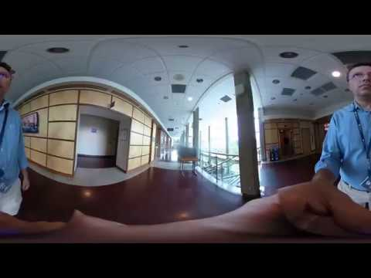
360 Video
Notes:
We won’t cover this, but it is very cool.

Slide 17
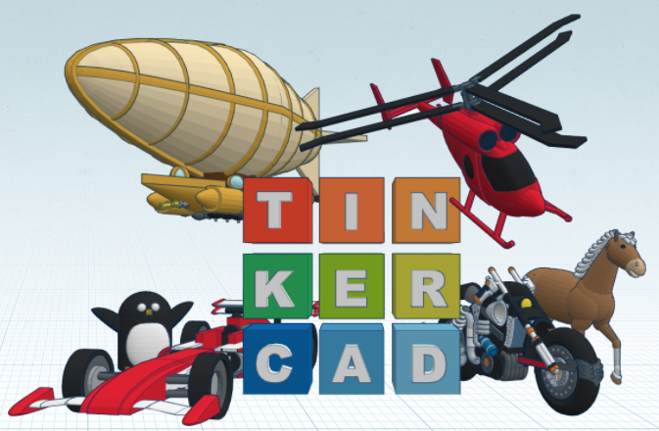
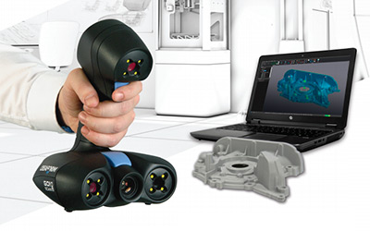
3D Model
Photogrammetry
3D Laser Scan
Notes:
Scanning with lasers
Modelling
Photogrammetry

Slide 18
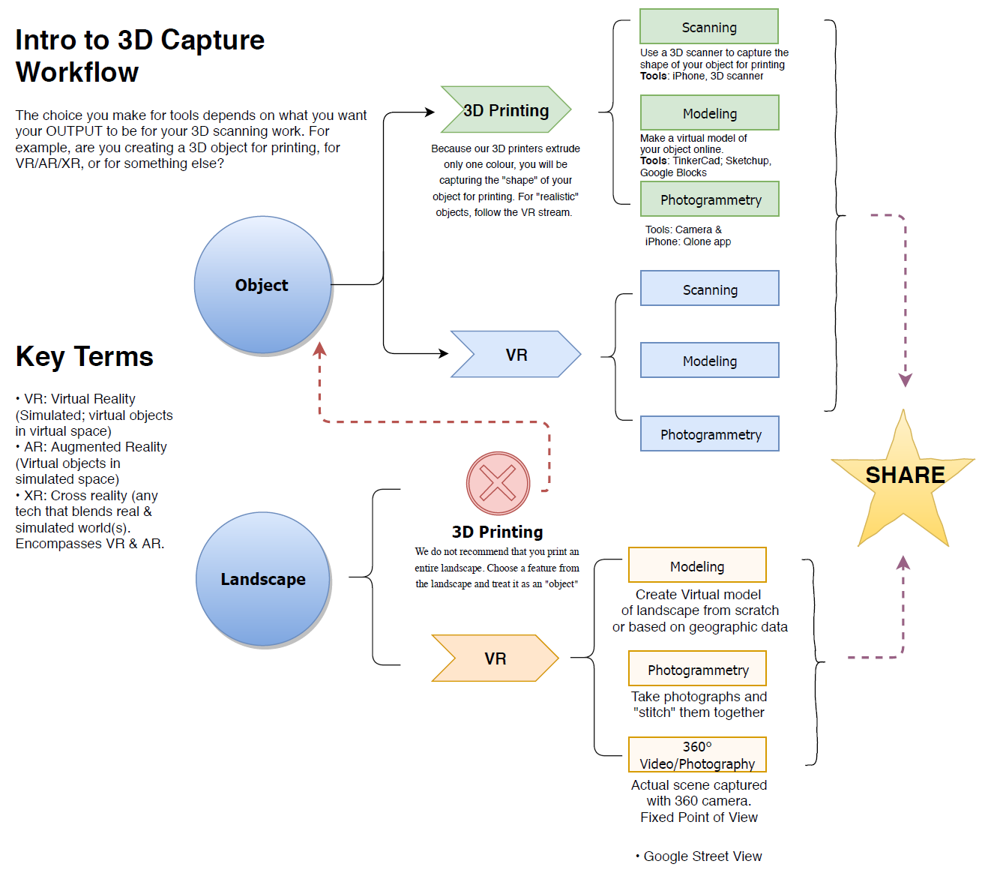
3D Capture Workflow
Notes:
3D Capture workflow

Slide 19
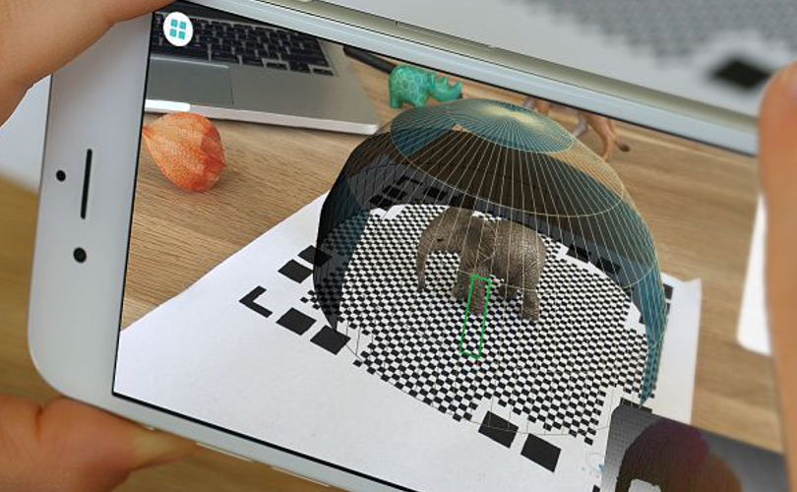
5 Important Tips...
Most object’s require a
2nd scan with a different
orientation.
Go slow when scanning.
Object needs to be stable.
Good lighting is important.
Three corners of mat need to be visible
at all times.
Notes:
4 Important Tips:
Most object’s require a 2nd scan with a different orientation.
Go slow when scanning.
Object needs to be stable.
Good lighting is important.

Slide 20
Let’s Do Some 3D Scanning!

Slide 21
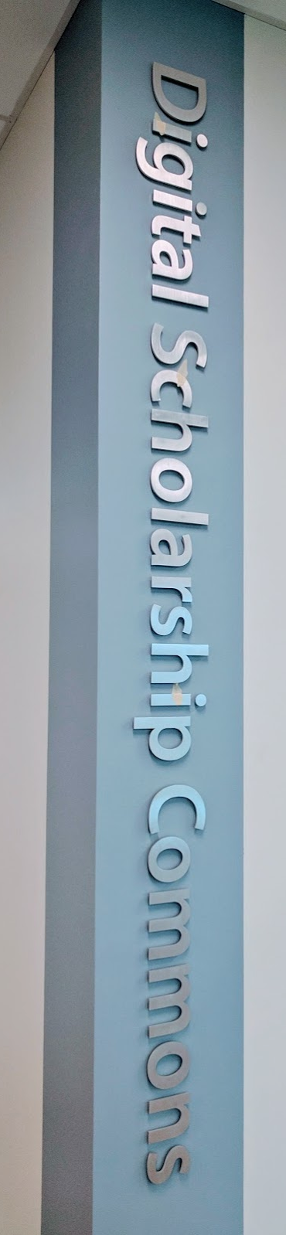
Questions or Comments?
Please Fill out our short Workshop Evaluation Form: bit.ly/dsc-eval
dscommons@uvic.ca
uvic.ca/library/dsc/

