Slide 1
Did apartheid begin in 1652, the 1800s, or 1948?
Tracing the historical origins of racial oppression in South Africa

Slide 2
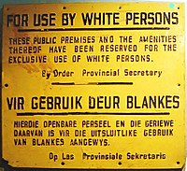
Basic “facts” about apartheid
What: system of legalized racism and segregation in South Africa
When: 1948-1990s
Why: belief in racial superiority, fear of black resistance

Slide 3
Learning objectives
Fundamental characteristics of apartheid – white control of black labour and land - existed in South Africa for hundreds of years before apartheid technically began in 1948
Historical “facts” are always interpretations, not set in stone

Slide 4
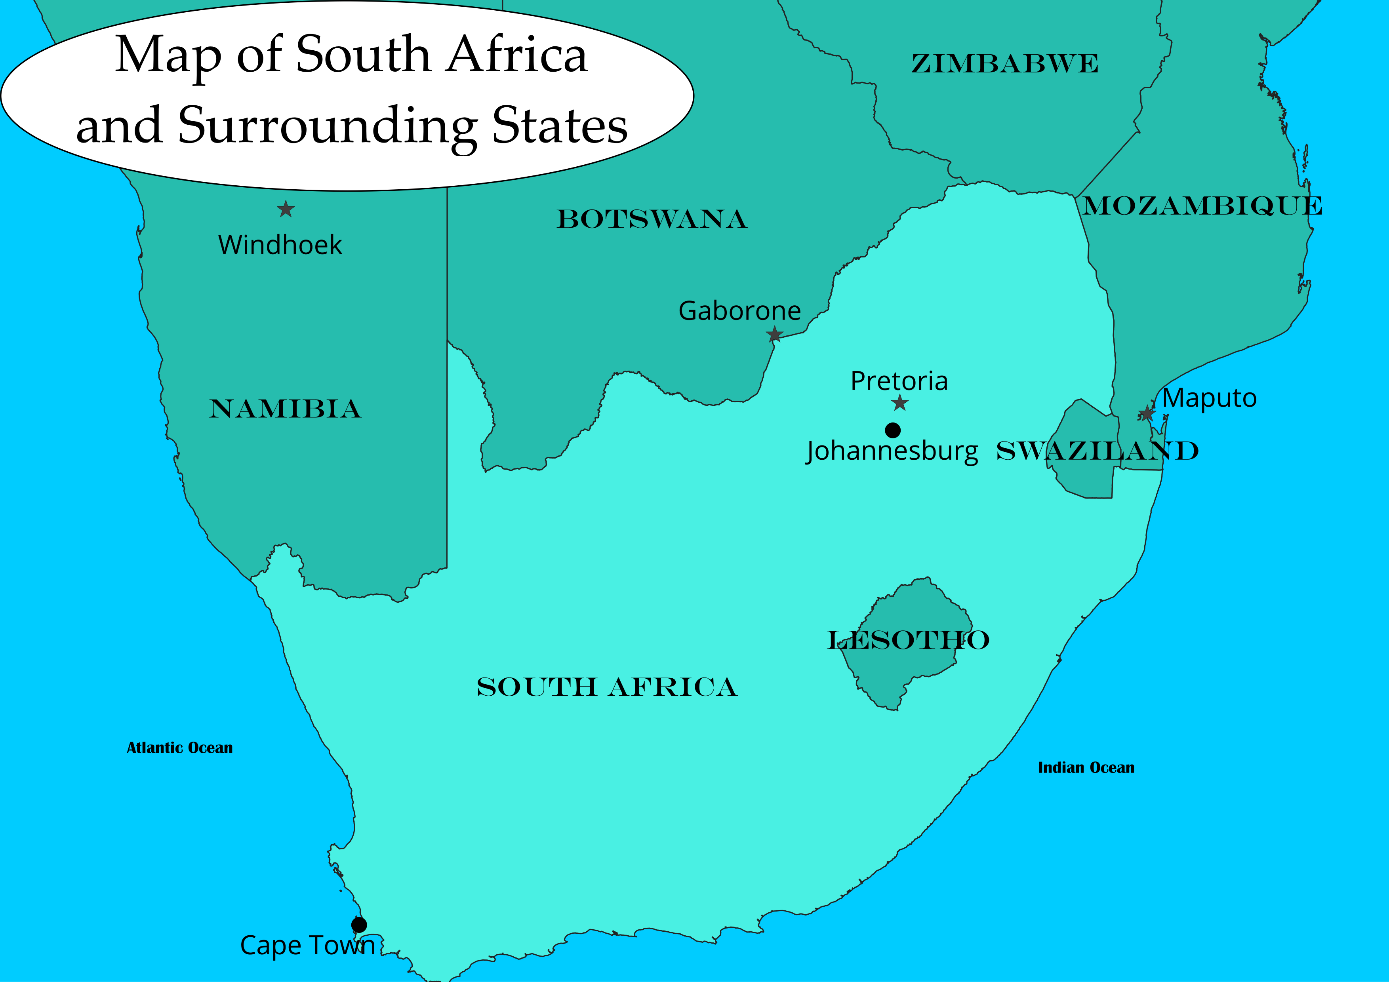
Modern South Africa
Population has always been primarily black African
Highly diverse: over 35 commonly used languages

Slide 5
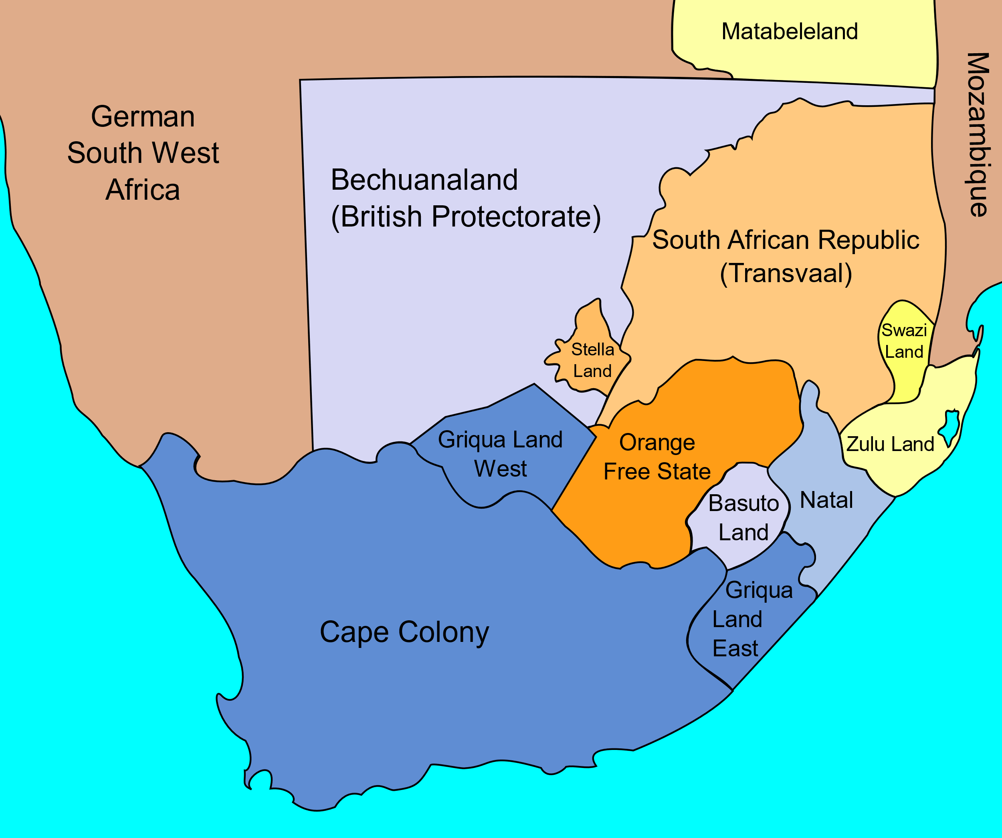
Colonial South Africa
British: Cape Colony and Natal
Afrikaner: Orange Free State and South African Republic

Slide 6
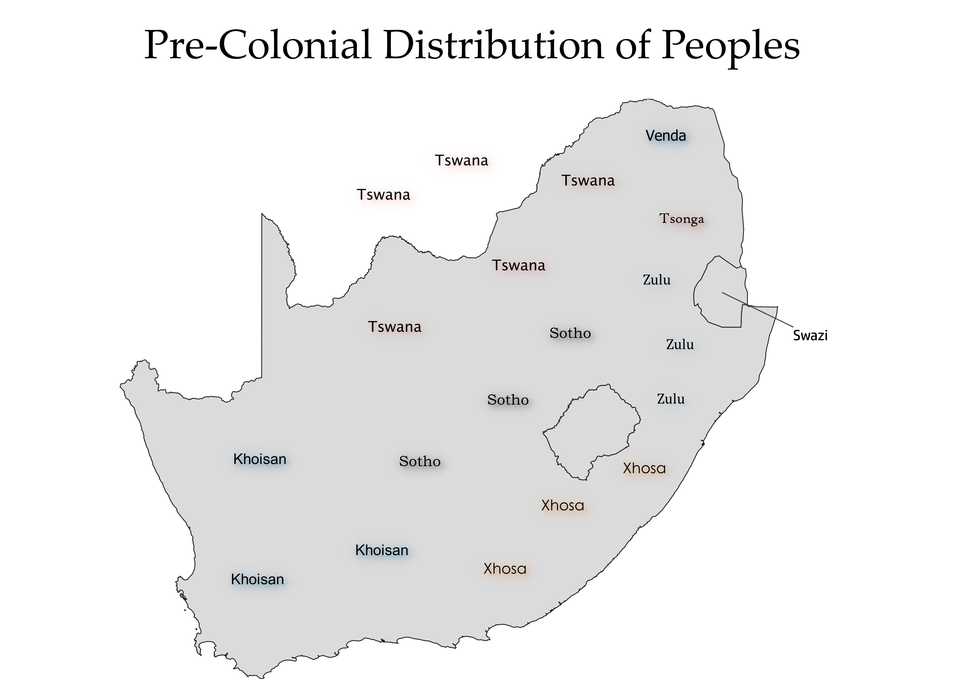
South Africa before colonization
Khoisan = Khoikhoi and San, often referred to as Indigenous
Black African groups: Xhosa, Zulu, Sotho, Tswana, Tsonga, Venda, Swazi, etc.

Slide 7
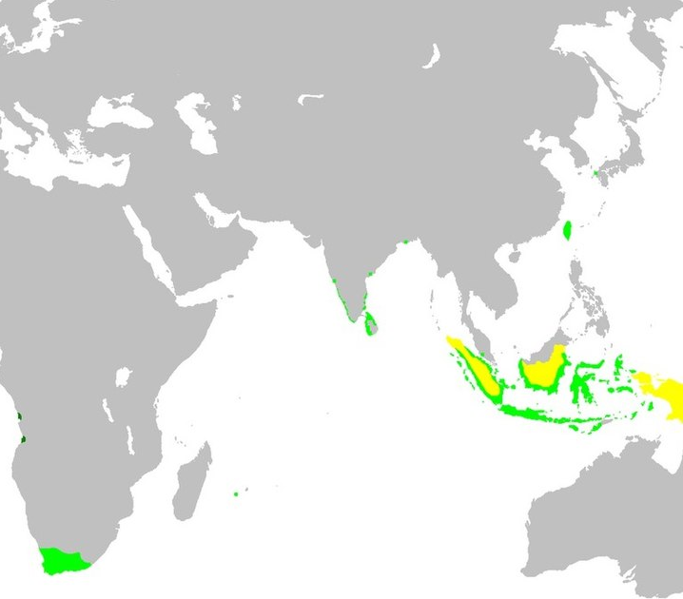
Kaap de Goede Hoop (1652)
Meant as refreshment station on journey to the East Indies

Slide 8
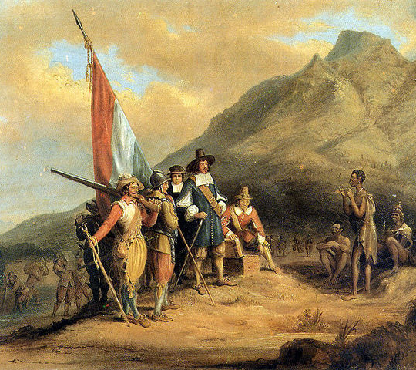
Kaap de Goede Hoop (1652)
Slavery was practiced from the beginning, but…
The Dutch imported slaves, they did not enslave the Khoikhoi and San

Slide 9
Kaap de Goede Hoop (1652)
Slavery existed, but not racism per se
Origins of apartheid?
  Yes – dependence on non-white labour
  No – non-white labour was imported

Slide 10
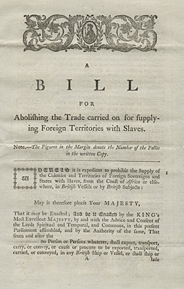
British South Africa and black labour
1806 Britain takes over the Cape Colony
1807 Britain abolishes slave trade, cutting off access to new slaves

Slide 11
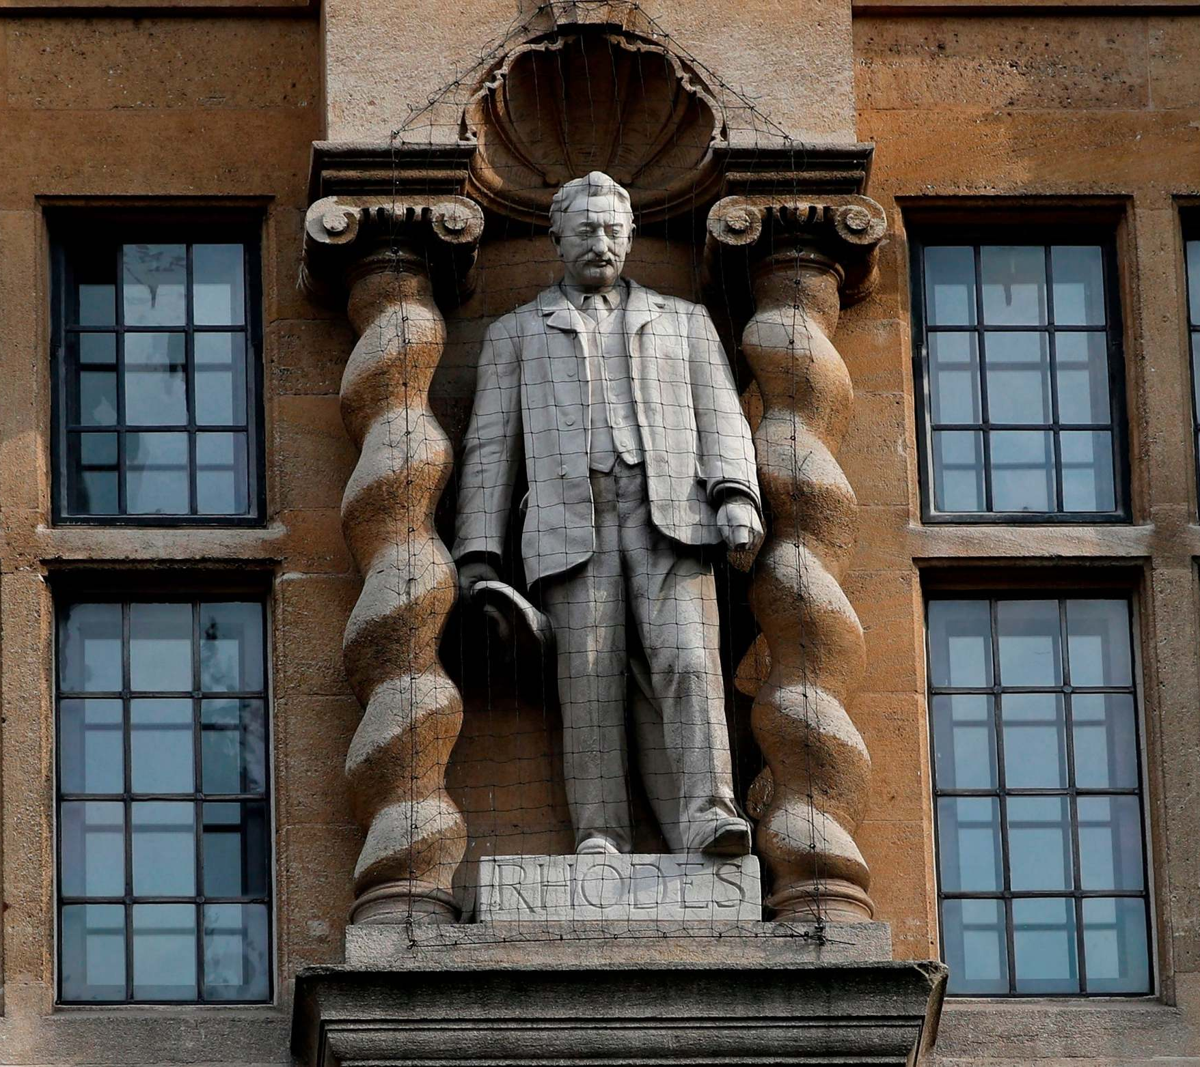
British South Africa and black labour
1809 “Hottentot Proclamation”
1841 Masters and Servants Act
1893 Mining Act

Slide 12
British South Africa and black labour
Origins of apartheid?
  Yes – control of black labour began in the 19th century and reiterated during apartheid
  No – apartheid was not just about labour, also about land

Slide 13
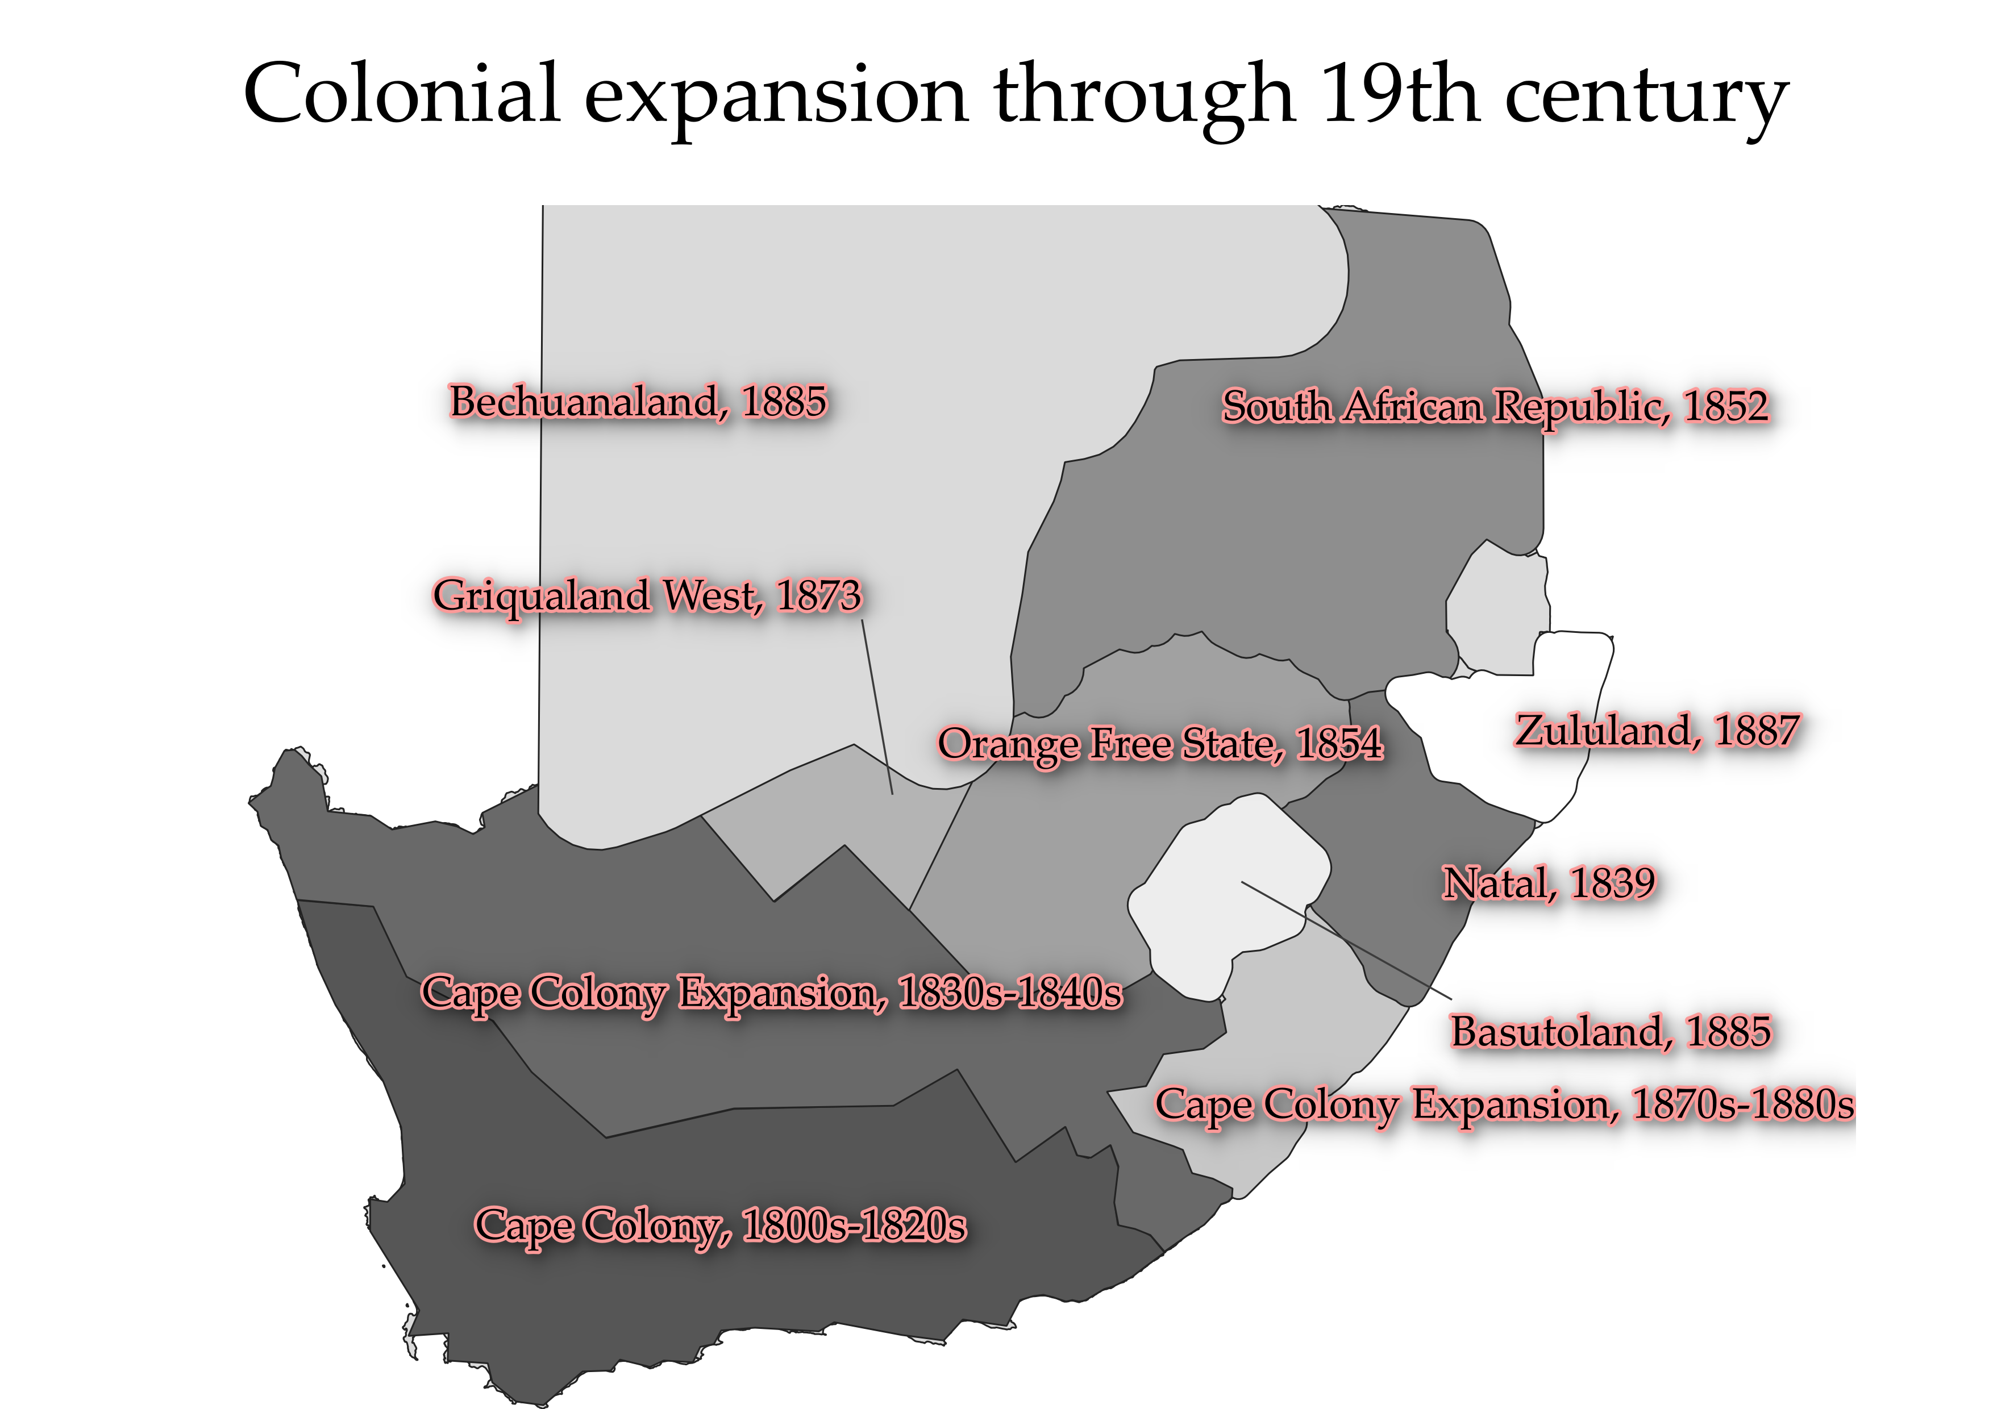
British South Africa and black land
Farms and ranches required land, so land was taken bit by bit
By 1887, all of modern South Africa was claimed by whites

Slide 14
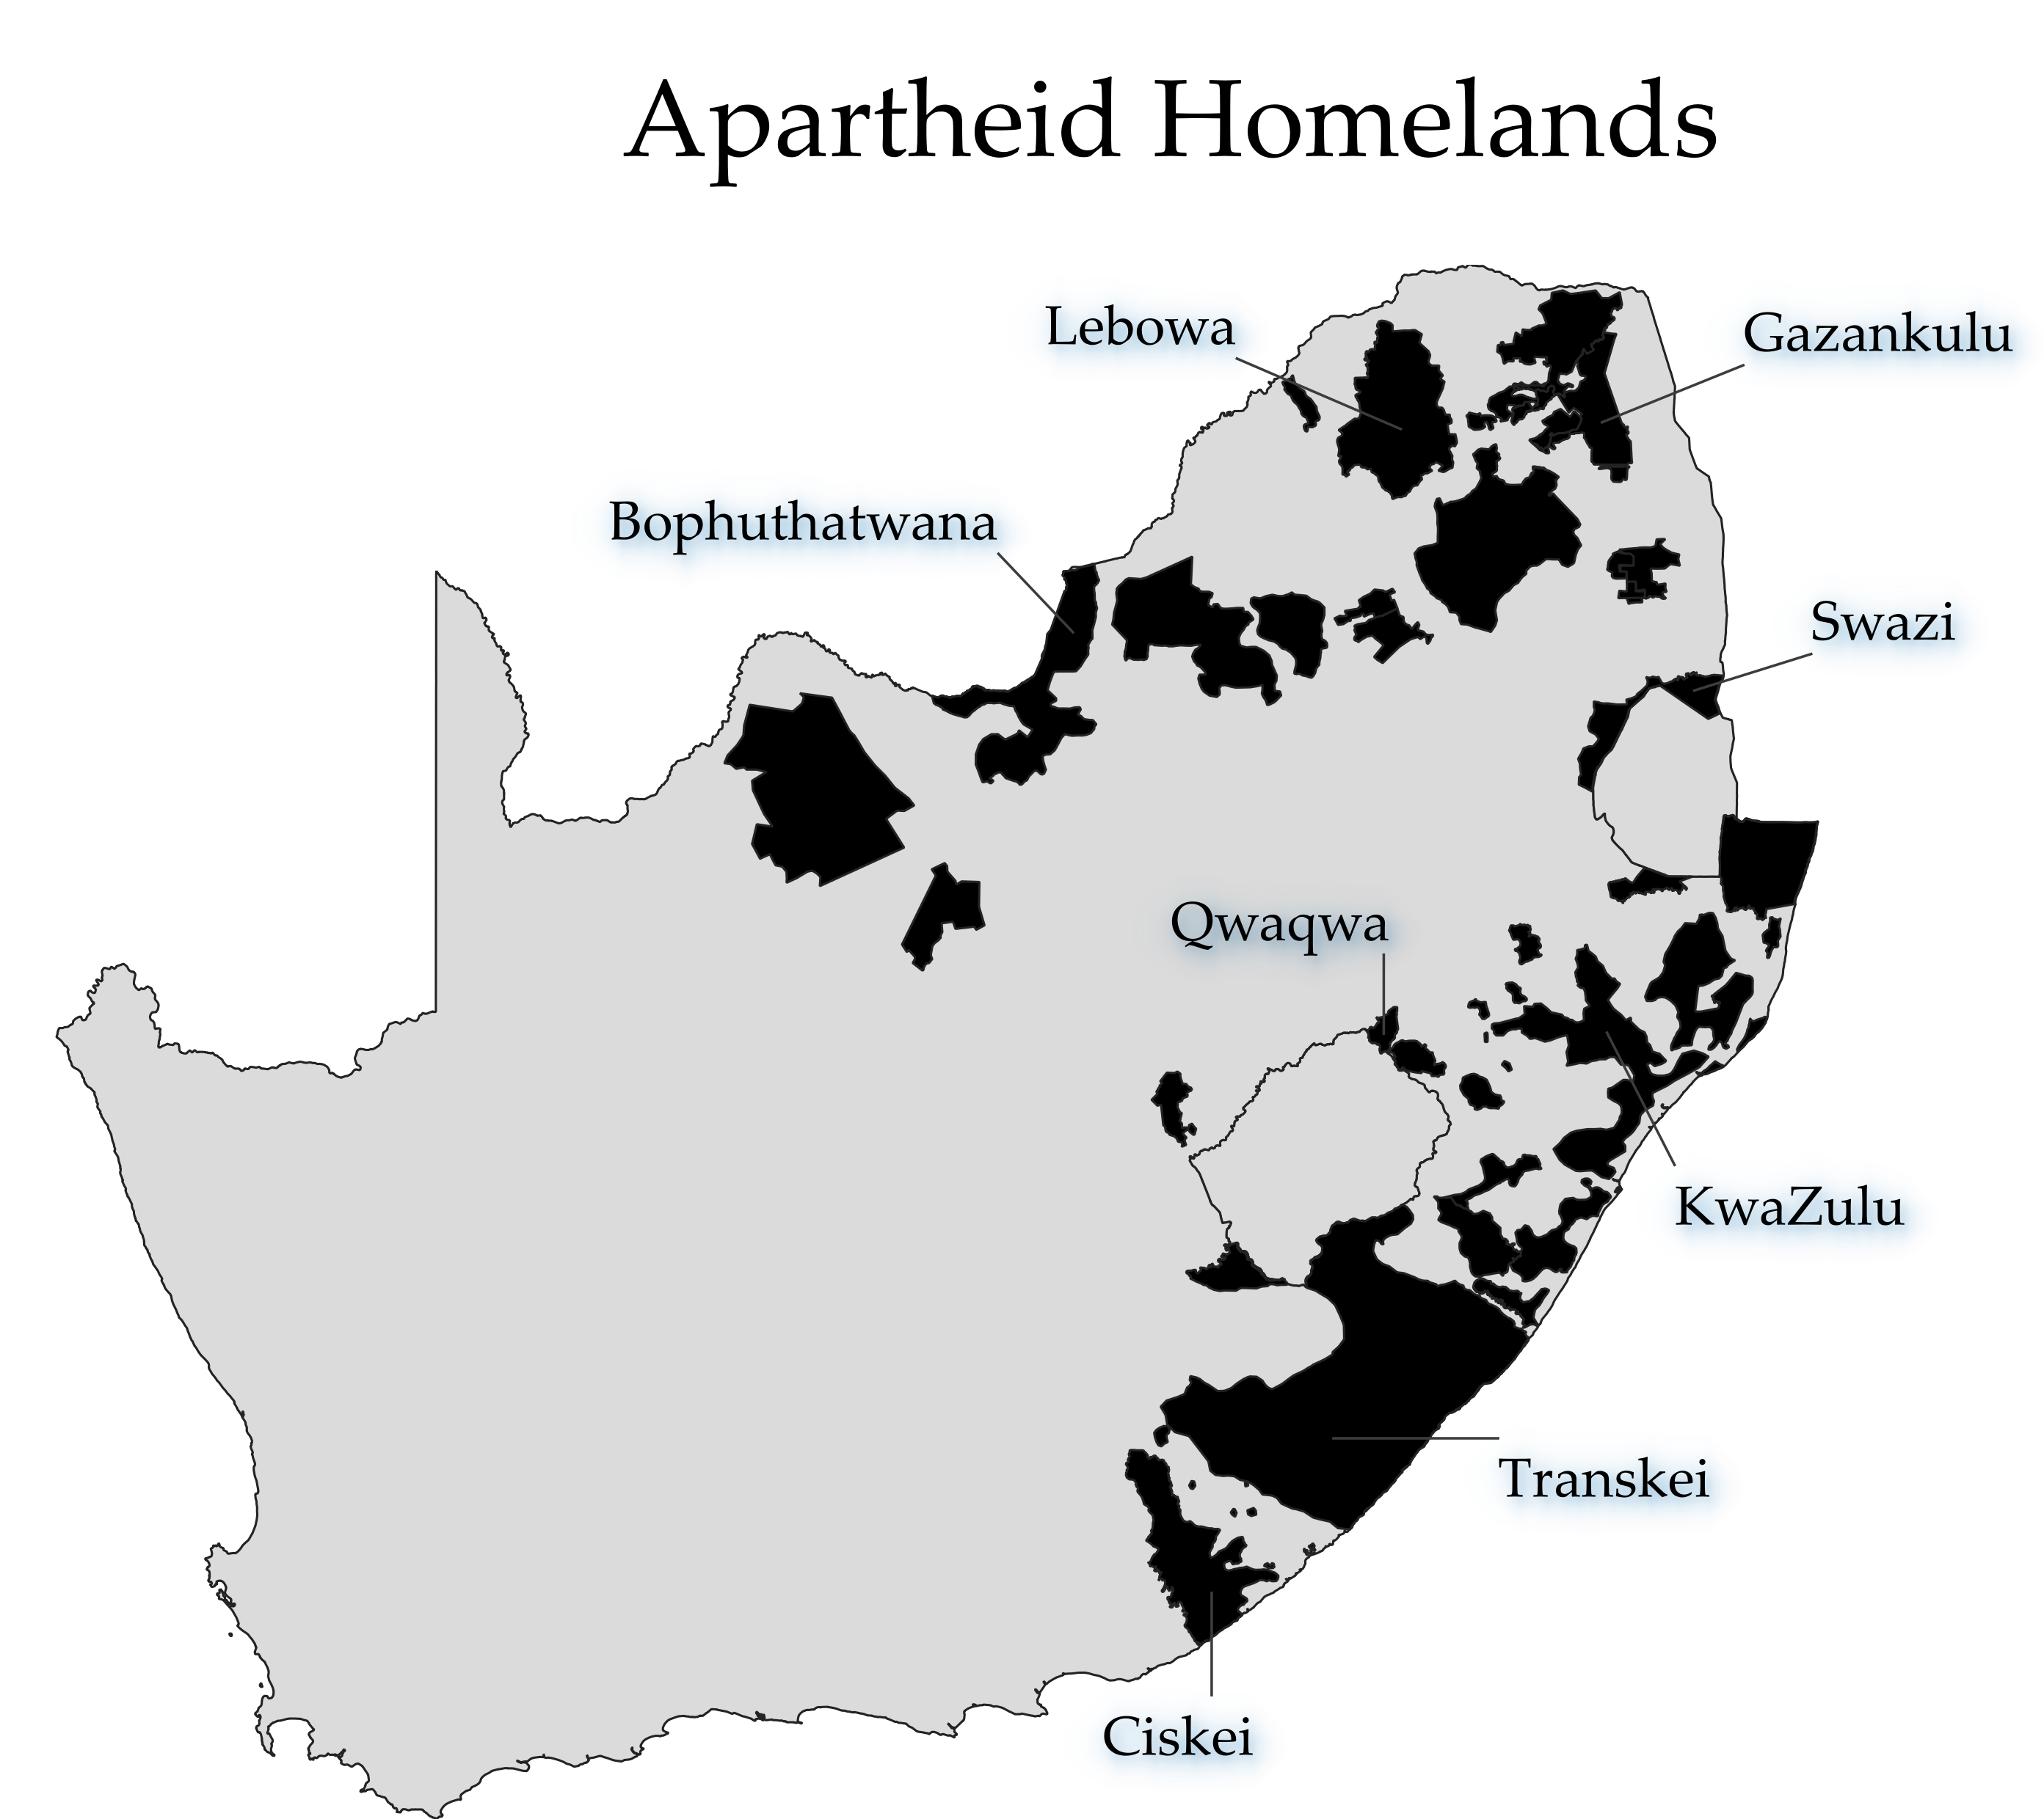
British South Africa and black land
1913 Natives Land Act set aside 7% of land for blacks, increased to 13% in 1936
Under apartheid, these became the “homelands”

Slide 15
British South Africa and black land
Origins of apartheid?
  Yes – apartheid was based on white control of land, and this was established in 19th century
  No – blacks in the 19th century could more or less own land anywhere

Slide 16
When did apartheid begin?
1652 and introduction of slavery?
1809/1841 and exploitation of local African labour
During the gradual dispossession of land over the 19th century?
1948 and “official” beginning of apartheid?

