Slide 1
VR, Videos, and Unity Workshop
Workshop time goes here!
For the UVic Libraries
Digital Scholarship Commons
Darren dreid820@uvic.ca
https://oac.uvic.ca/dsc/

Slide 2
The Itinerary:
Take a look at Unity’s capabilities
Quick review of some key skills
Create our own Roll-A-Ball game!
Review how to save and publish the final product

Slide 3
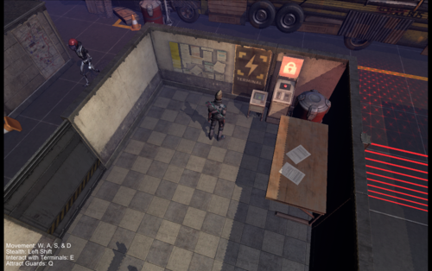
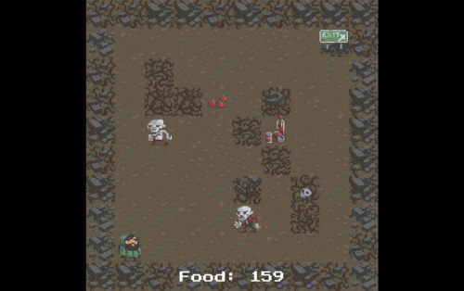
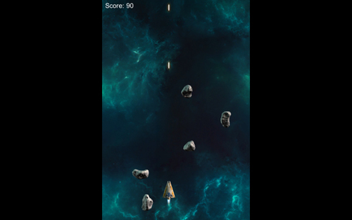
What Unity Can Do...
Images: http://johnthompsondesign.com/unity-3d/

Slide 4
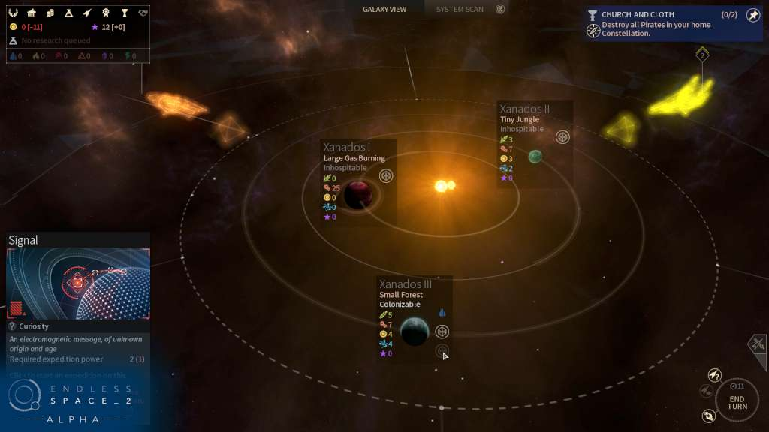
Unity is used by professionals
Game: Endless Space 2 (2017)

Slide 5
Key Skills Review
Undo - ctrl+z or cmd+z
Locate Position, Rotation, and Scale numbers in Inspector Panel
Hold middle mouse button and drag to pan
Hold right mouse button and drag to rotate
Mouse wheel to zoom in and out
Press play button to start Play Mode AND press it again to exit (important)
www.goo.gl/8nG9Jw - Check here for a list of useful Keybinds

Slide 6
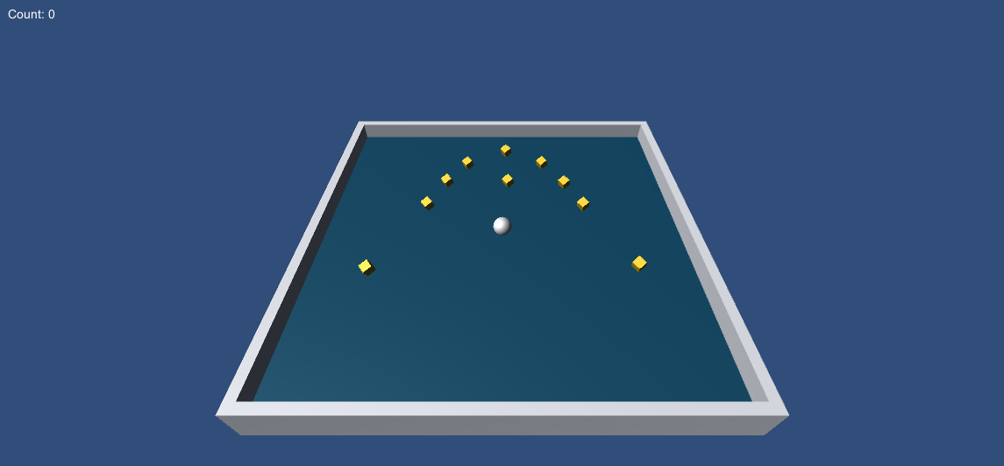
In-Class Activity

Slide 7
Help us Improve!
What worked, what didn’t...
Please Fill out our short Workshop Evaluation Form: LINK GOES HERE
-or-
Check your email for a link to
the form. Thanks!

Slide 8
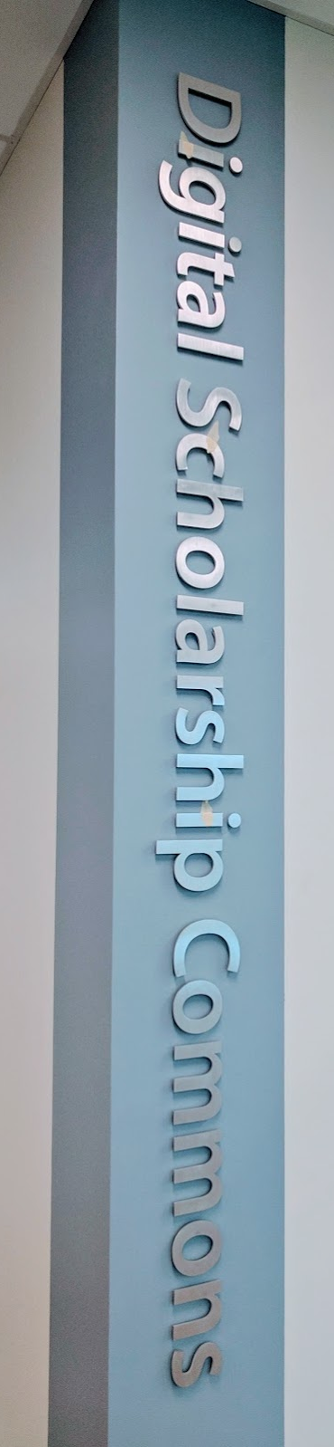
Questions or Comments?
Rich McCue
dscommons@uvic.ca
https://oac.uvic.ca/dsc/

